Slide 1

Group 05 Project

Slide 2
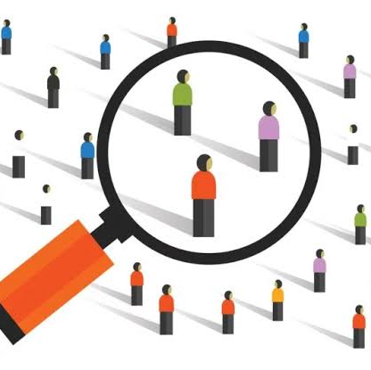
Introduction
Customer Personality Analysis is a detailed analysis of a company’s ideal customers. It helps a business to better understand its customers and makes it easier for them to modify products according to the specific needs, behaviours and concerns of different types of customers.
Customer personality analysis helps a business to modify its product based on its target customers from different types of customer segments. For example, instead of spending money to market a new product to every customer in the company’s database, a company can analyse which customer segment is most likely to buy the product and then market the product only on that particular segment.

Slide 3

Business problem
Need to perform clustering to summarize customer segments.

Slide 4
Data cleaning
Understood the data using info
Detected the null values in the data. Which is just 1% so dropped those observations using df = df.dropna()
Then checked for the duplicates using df.duplicated().sum()
Concluded there are no duplicate records in the data
Also replaced 'Alone’, 'Absurd’, 'YOLO’ from marital status with single.
Then we dropped the 'Z_CostContact','Z_Revenue’ columns as they are not contributing towards the remaining columns.

Slide 5
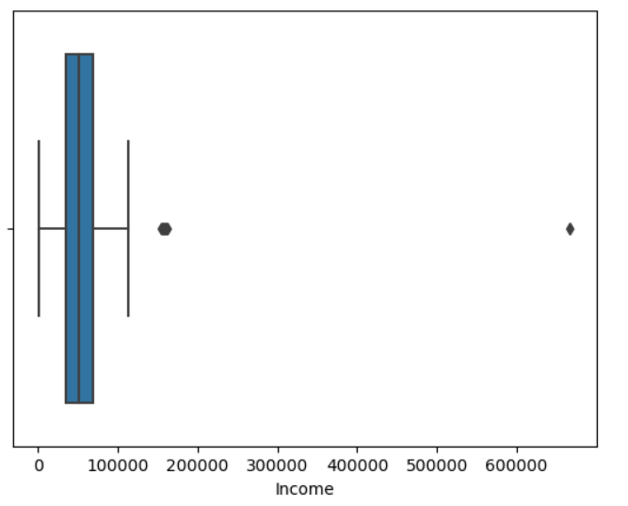
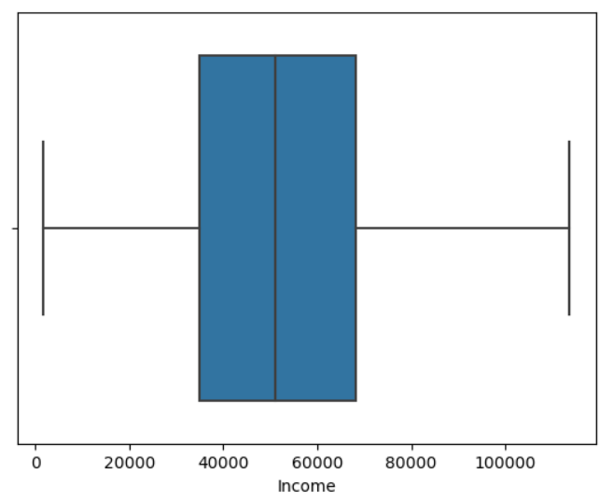
Detected outliers in the Income column
iqr_value = df['Income'].quantile(0.75) - df['Income'].quantile(0.25)
MntMeatProducts_outliers = (df['Income'] < df['Income'].quantile(0.25) - 1.5 * iqr_value) | (df['Income'] > df['Income'].quantile(0.75) + 1.5 * iqr_value)
df.loc[MntMeatProducts_outliers, 'Income'] = iqr_value
And adjusted them with iqr values

Slide 6
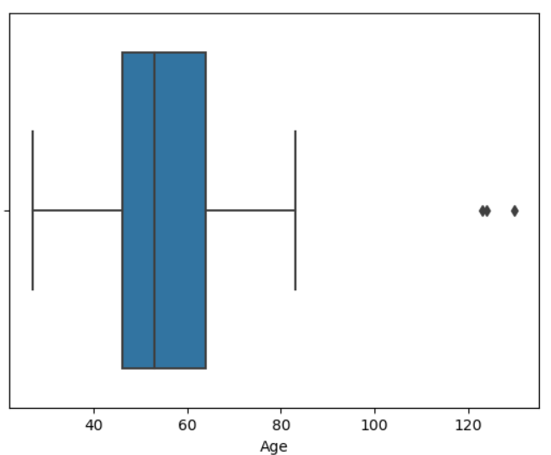
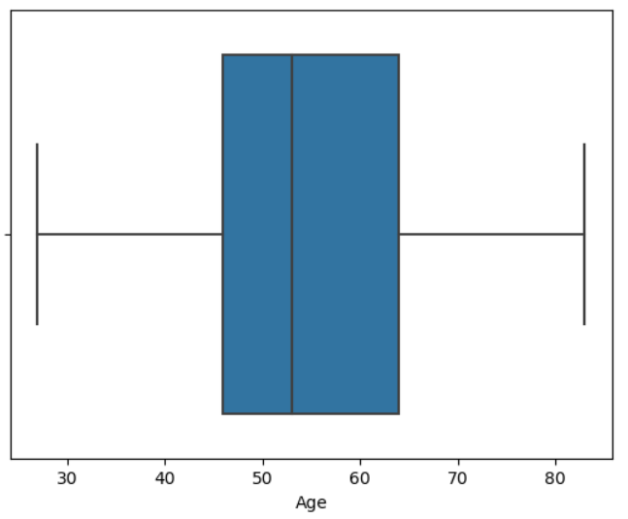
Detected outliers in the age column and adjusted them with iqr values
Q1 = np.percentile(df['Age'], 25)
Q3 = np.percentile(df['Age'], 75)
IQR = Q3 - Q1
df = df[(df["Age"]>=Q1- 1.5*IQR) & (df["Age"]<=Q3+ 1.5*IQR)]

Slide 7
Feature engineering
Here we have to reduce the features for better clustering
df['Expenses'] = df['MntWines'] + df['MntFruits'] + df['MntMeatProducts'] + df['MntFishProducts'] + df['MntSweetProducts'] + df['MntGoldProds’]
Converted spendings on different products into one feature as ‘Expenses’.
df['Children'] = df['Kidhome'] + df['Teenhome’]
Converted kids and teens as children.
df['Education'] = df['Education'].replace({'Basic':'Undergraduate', '2n Cycle':'Undergraduate', 'Graduation':'Graduate', 'Master':'Postgraduate', 'PhD':'Postgraduate’})
Just taken Education of a customer into 3 categories
df['Campaign'] = df['AcceptedCmp1'] + df['AcceptedCmp2'] + df['AcceptedCmp3'] + df['AcceptedCmp4'] + df['AcceptedCmp5’]
Considered all the campaigns and combines into one column as ‘Campaign’.
df['Marital_Status'] = df['Marital_Status'].replace({'Married':'Partner', 'Together':'Partner' , 'Widow':'Alone', 'Divorced':'Alone', 'Single':'Alone’})
Replaced Married and Together categories with ‘Partner’ and Widow, Divorced, Single categories with ‘Alone’
df['NumPurchases'] = df['NumDealsPurchases'] + df['NumWebPurchases'] + df['NumCatalogPurchases'] + df['NumStorePurchases'] + df['NumWebVisitsMonth’]
Taken ‘NumPurchases ’ as a column and in this feature we have merged all the purchasing type features.
Finally droped all the features which are used to make a strong single features.

Slide 8
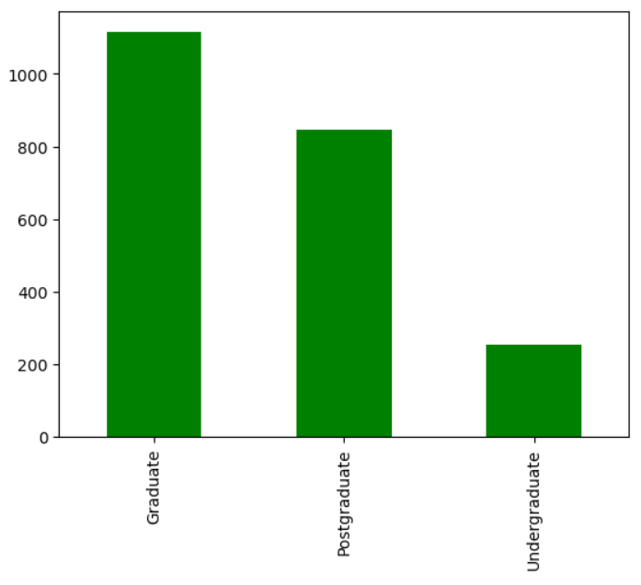
Univariate analysis
Understanding the categorical variables using bar plot.
We have 3 categories in the Education column. In which the graduate category has more than 1000 people.
And postgraduate people are 800
Undergraduates are less in number compared to other categories.

Slide 9
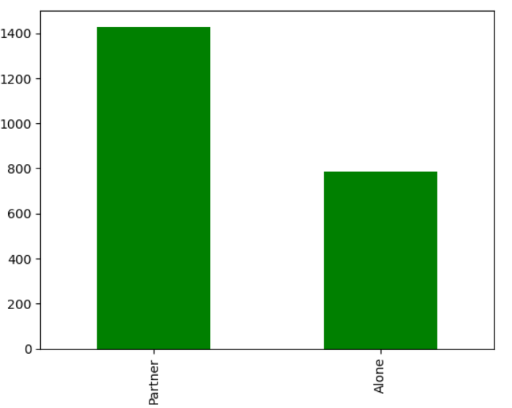
Bar plot for another categorical variable Marital Status
We can see the data contains less number of alone(800) customers compared to partner customers(1400).

Slide 10
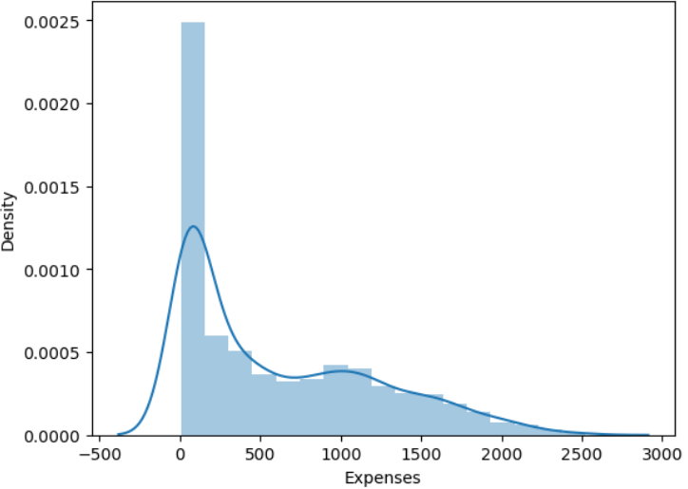
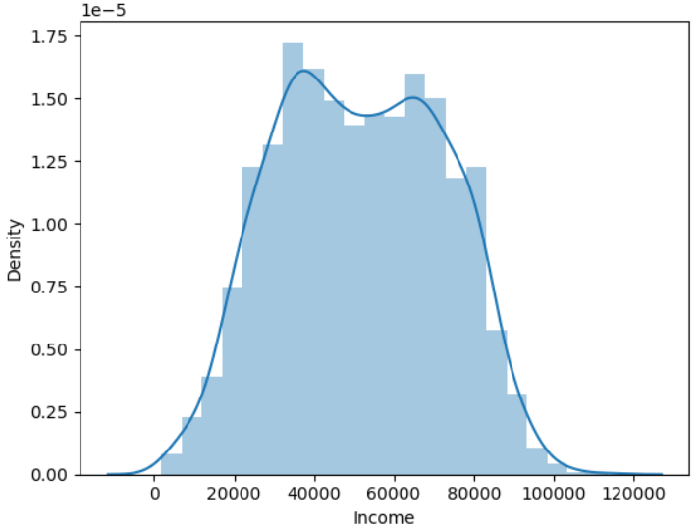
Distribution plot for expenses of customer which is right skewed.
Distribution plot for the income of the customer which is symmetric.

Slide 11
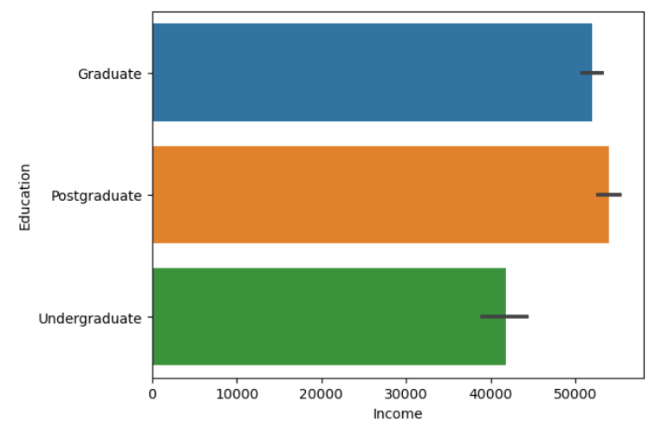
Bivariate analysis
In this bar chart we are comparing the Education and Income of a customer. We can observe the postgraduate customers have the highest income that is >50000, graduates are earning around 50000, followed by Graduates earning >40000.

Slide 12
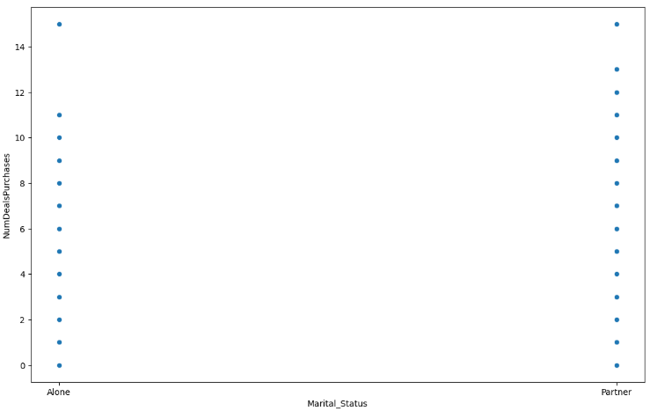
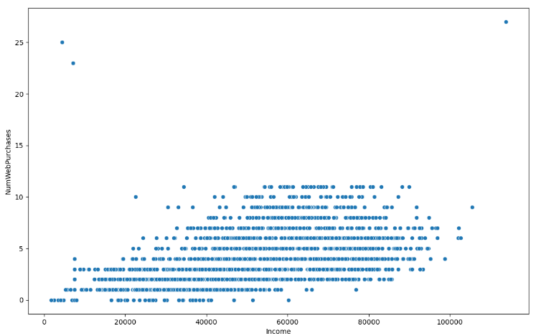
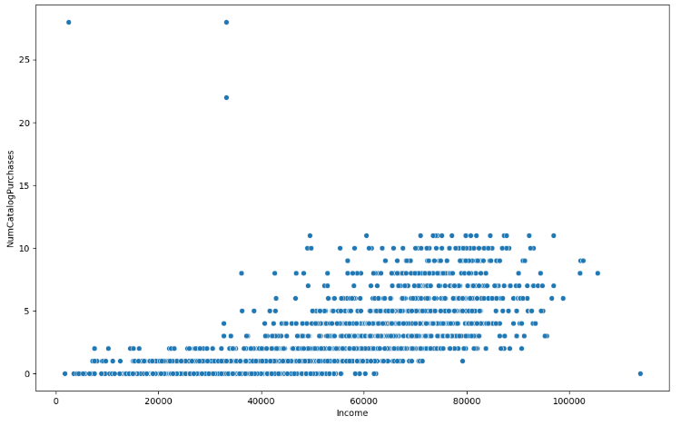
Plotted scatter plot for the ‘Marital_Status’ .'NumDealsPurchases’.which scattered which is linear.
Plotted scatter plot for the 'Income', 'NumWebPurchases’. The high income customers are purchasing more on web.
Plotted scatter plot for the 'Income', 'NumCatalogPurchases’ The customers which has income between 60000 – 90000 are going with catalog purchasing.

Slide 13
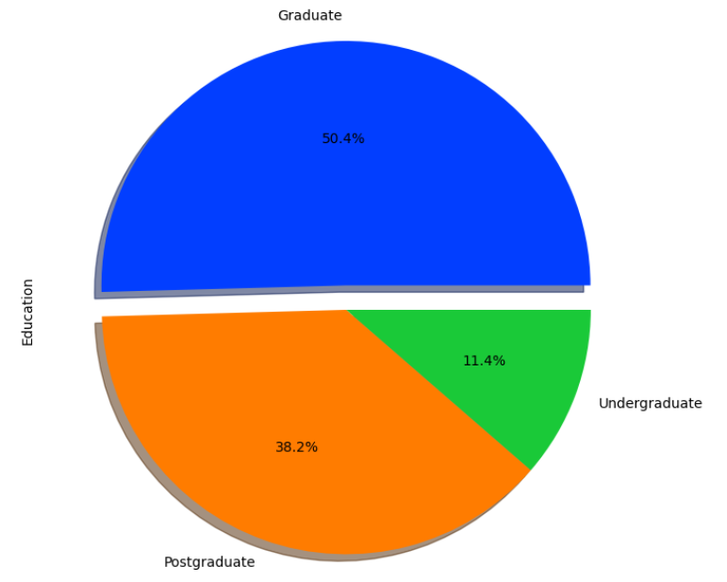
Pie chart to know the customer education percentage.

Slide 14
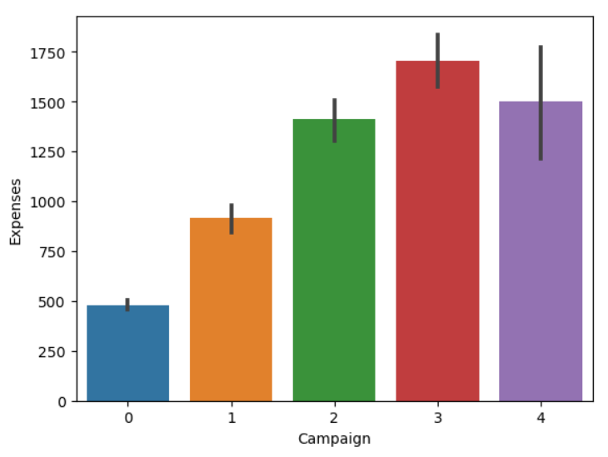
Bar graph between campaigns and Expenses, here we can observe customers who accepted the campaign 3 had more expenses, followed by campaign 4 customers, campaign 2 customers has less than 3&4. The least expenses are customers who does’nt accepted any campaign.

Slide 15
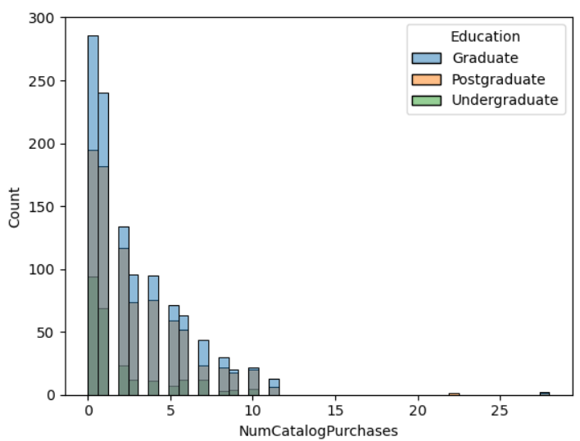

Slide 16
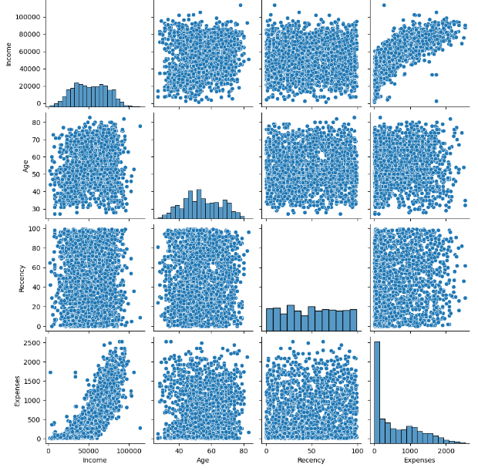
Multivariate analysis

Slide 17
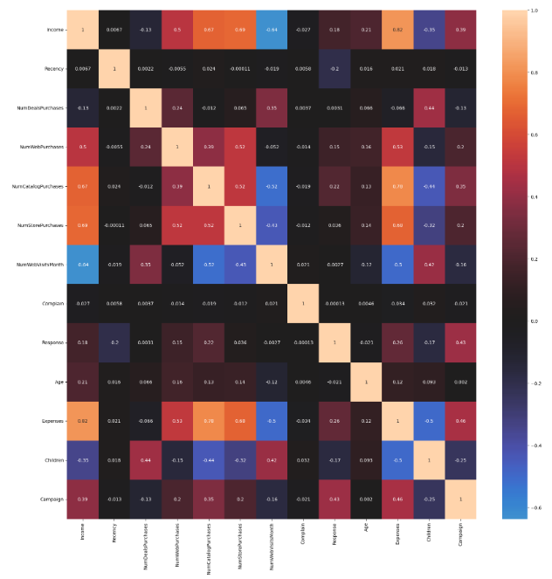
Correlation analysis

Slide 18
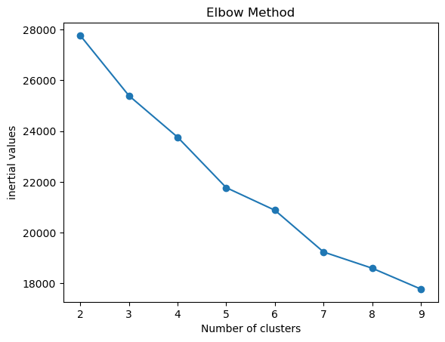
Elbow graph for kmeans clustering

Slide 19
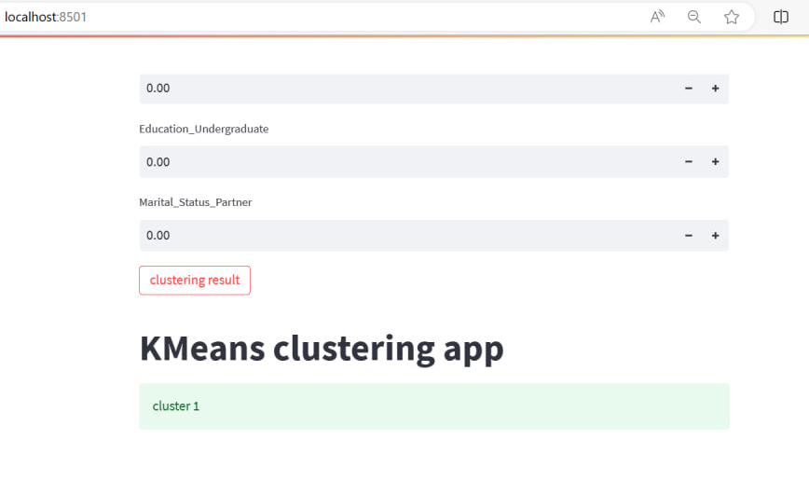
Silhouette scores:
Silhouette score for dbscan is 0.518
Silhouette scorefor Kmeans is 0.166
Silhouette score for Agglomerative clustering is 0.152

Slide 20
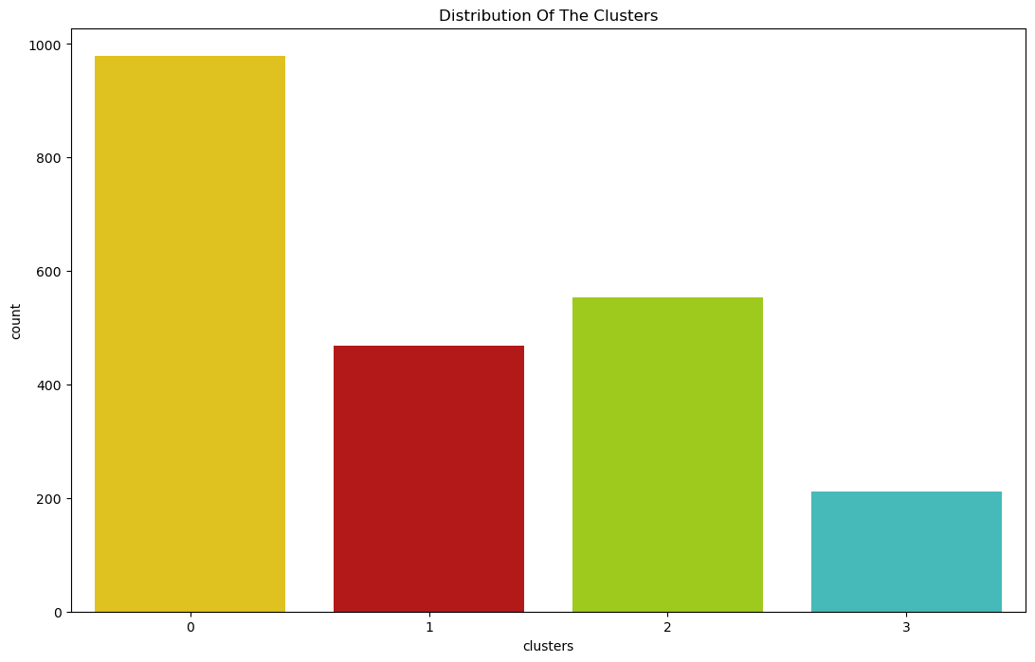
Distribution of clusters

Slide 21
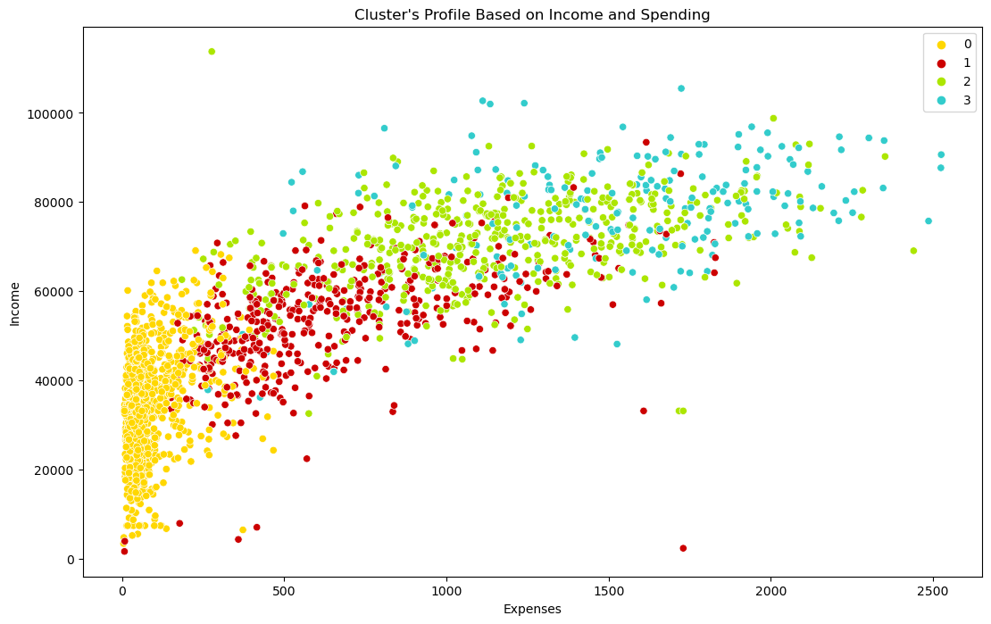
Cluster's Profile Based on Income and Spending

Slide 22
Summary
cluster 0:Low expenses high income
cluster 1:Average Spendings Average income
cluster 2:High Income Average Expenses
cluster 3:High expenses High Income

Slide 23

deployment

Slide 24


Thank you

